Slide 1
BIOL 350: Bioinformatics
Introduction to genetic association studies

Slide 2
What is a SNP?
Polymorphisms and their role in genetics

Slide 3
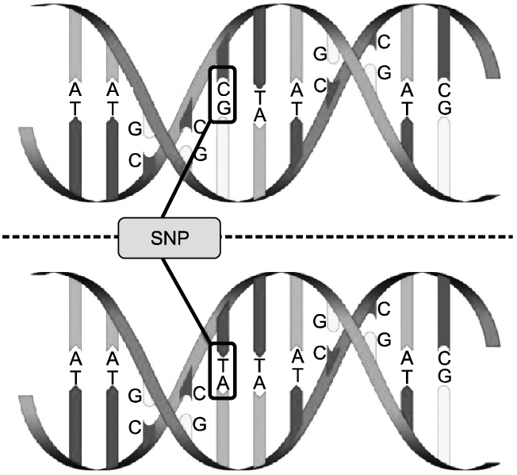
Single-nucleotide polymorphisms
Polymorphism is the tendency of DNA to admit of different nucleotide pairs at a single locus

Slide 4
Single-nucleotide polymorphisms
Of 3.2 billion bases, any individual is polymorphic at 4–5 million sites

Slide 5
Single-nucleotide polymorphisms
The more common allele is called the major allele
The less common allele is called the minor allele

Slide 6
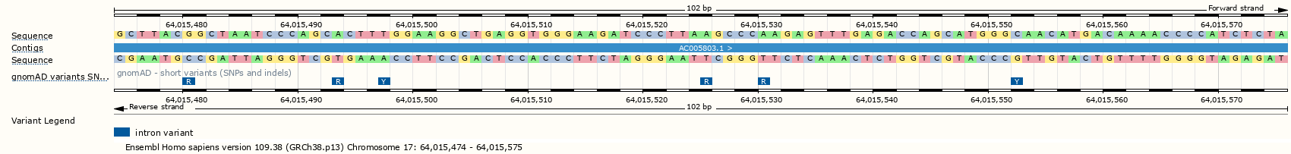
IUPAC-IUB SNP codes
More than just A, T, G, and C?

Slide 7
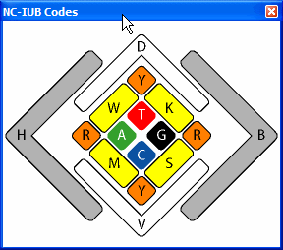
IUPAC-IUB SNP codes
Each polymorphism is coded by its possible alleles
https://www.gendx.com/SBTengine/Help_220/hs310.htm

Slide 8
IUPAC-IUB SNP codes
Code | Meaning | Explanation
R | A or G | PuRrine
Y | C or T | PYrimidine
S | G or C | Strong H-bonding
W | A or T | Weak H-bonging
K | G or T | Keto bases
M | A or C | aMino bases
B | C or G or T | not A
D | A or G or T | not C
H | A or C or T | not G
V | A or C or G | not T
N | A or C or G or T | ANy
Each polymorphism is coded by its possible alleles

Slide 9
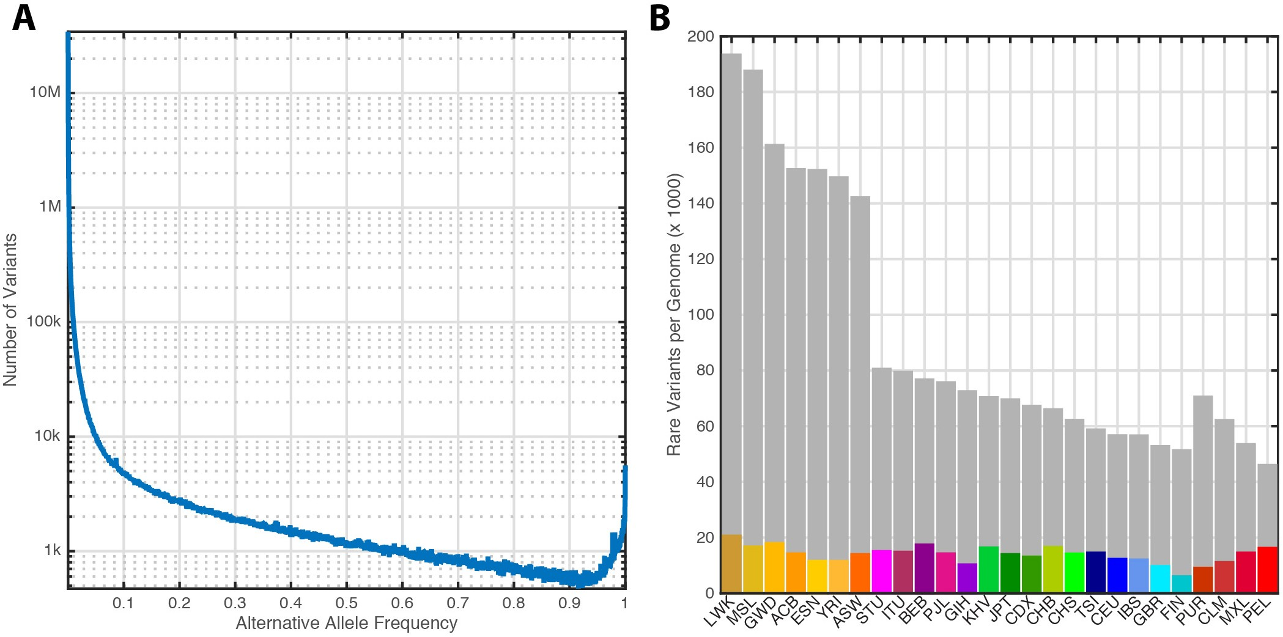
Many rare SNPs
Common SNPs have minor allele frequency (MAF) >5%
https://www.nature.com/articles/nature15393

Slide 10
Many rare SNPs
Most SNPs of the >600 million known SNPs are very rare (frequency < 0.5%)
https://www.nature.com/articles/nature15393

Slide 11
Many rare SNPs
But only <5% of an individual’s genome consists of rare SNPs
https://www.nature.com/articles/nature15393

Slide 12
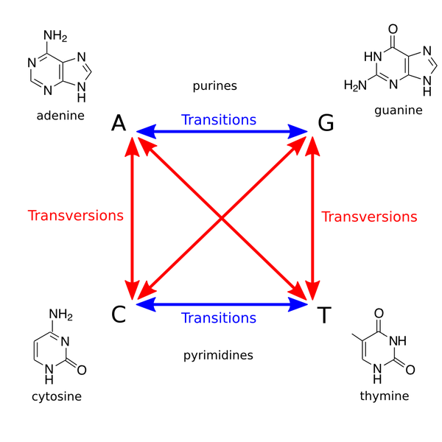
Transitions and transversions
Transitions occur between nucleotides of the same type (purines or pyrimidines)
Transversions occur between nucleotides of opposite type (between purines and pyrimidine)

Slide 13
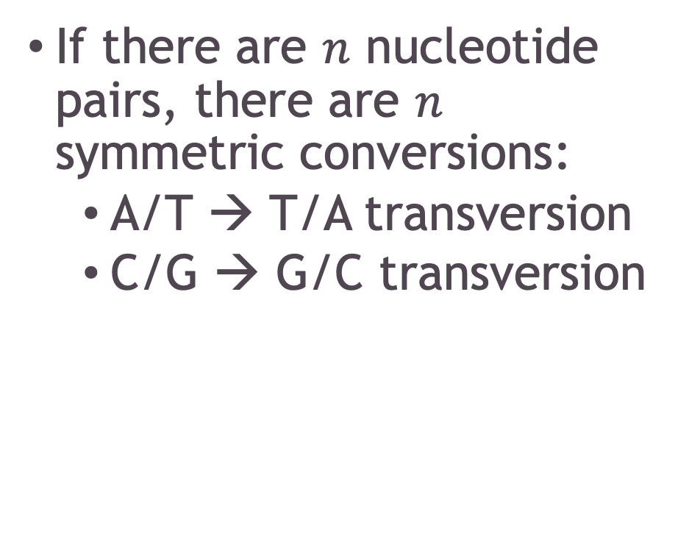
How many polymorphisms are there?
If there are $n$ nucleotide pairs, there are $n$ symmetric conversions:
A/T → T/A transversion
C/G → G/C transversion

Slide 14
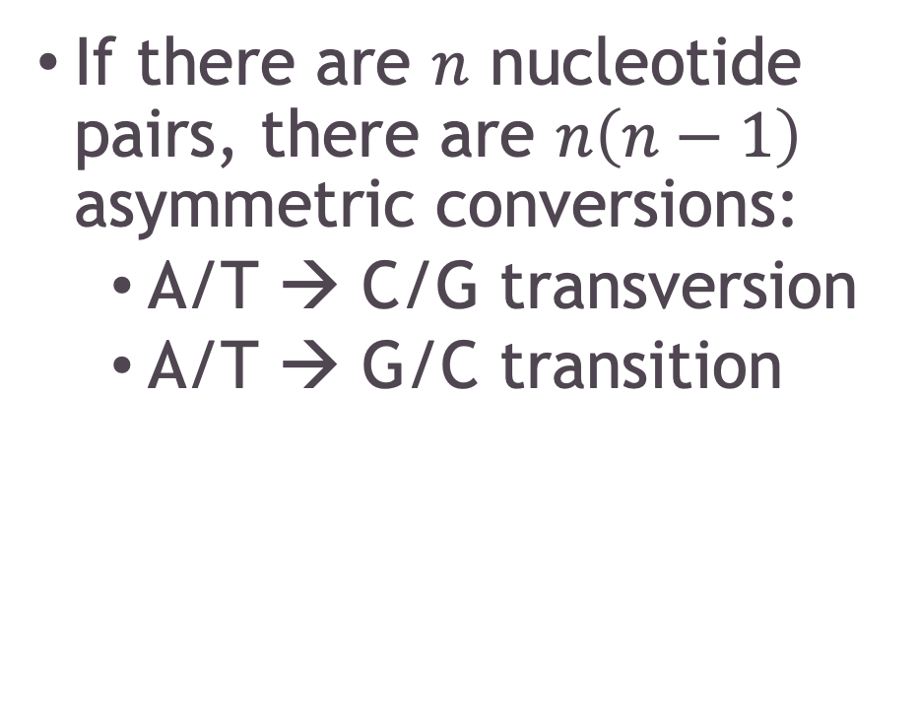
How many polymorphisms are there?
If there are $n$ nucleotide pairs, there are $n\left(n−1\right)$ asymmetric conversions:
A/T → C/G transversion
A/T → G/C transition

Slide 15
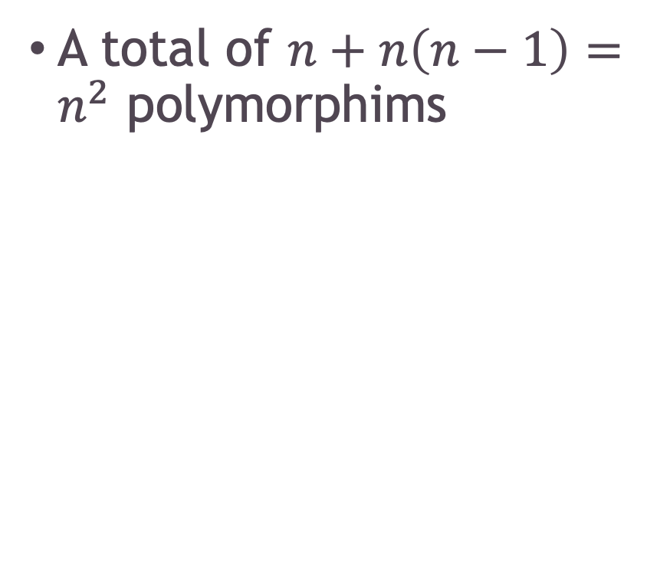
How many polymorphisms are there?
A total of $n+n\left(n−1\right)=n^{2}$ polymorphims

Slide 16
Transition-transversion ratio
Even though there are three times as many transversions possible as transitions, in humans the ratio of transitions to transversions is approximately 2, genome-wide
https://pubmed.ncbi.nlm.nih.gov/25297068/

Slide 17
Transition-transversion ratio
In coding regions, the Ti:Tv ratio is as high as 3
https://pubmed.ncbi.nlm.nih.gov/25297068/

Slide 18
Generation of sequencing data
Sequencing technologies and data formats

Slide 19
How do we get human genotypes?
SNP Chips
Whole-genome sequencing

Slide 20
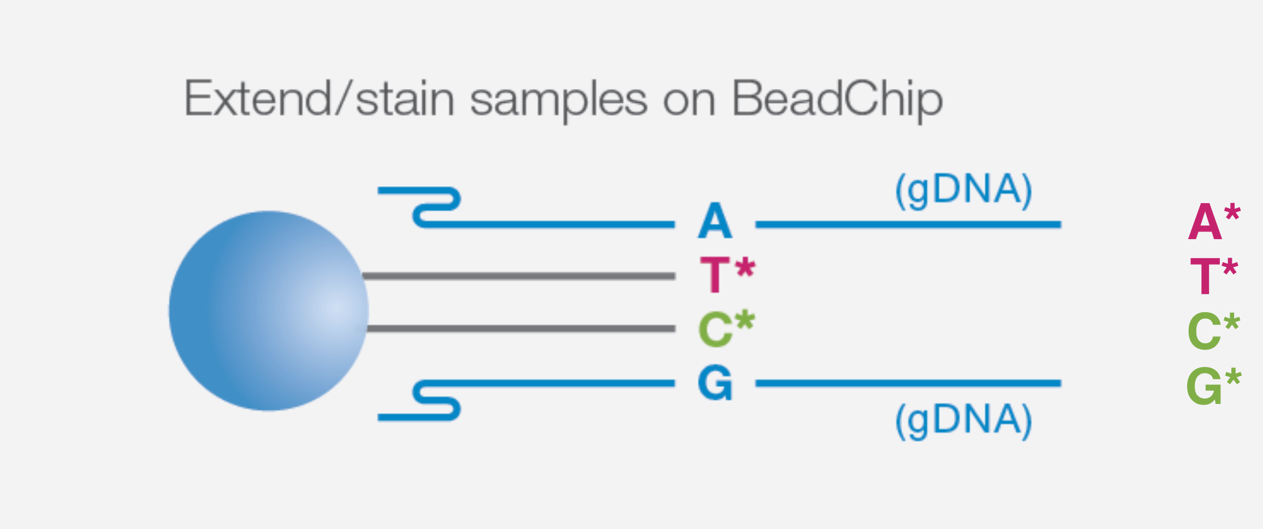
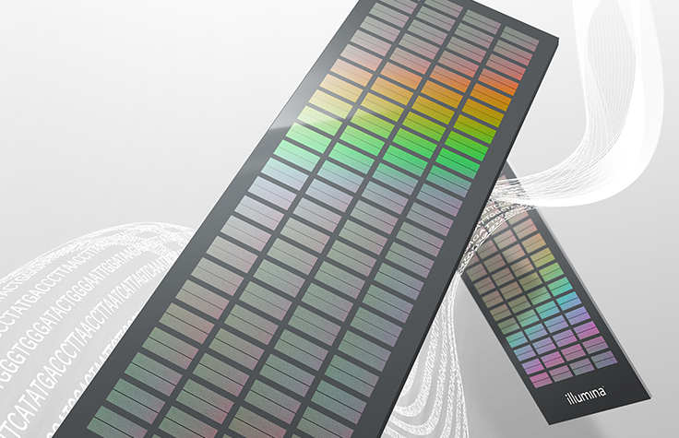
SNP Chips
Genomic DNA binds to a complementary sequence and incorporates a fluorescently labelled nucleotide

Slide 21
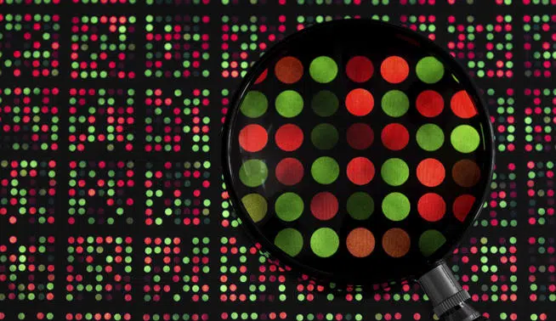
SNP Chips
The ratio of red to green at a spot identifies the sample allele

Slide 22
Whole-genome sequencing (WGS)
DNA fragments from a sample are attached to a flow cell and amplified
Clark et al. Molecular Biology (3rd Edition). Ch. 8: DNA Sequencing, 240-269 (2019)

Slide 23
Whole-genome sequencing (WGS)
Sequencing by synthesis: Short reads are produced as fluorescent nucleotides are incorporated one base at a time
Clark et al. Molecular Biology (3rd Edition). Ch. 8: DNA Sequencing, 240-269 (2019)

Slide 24
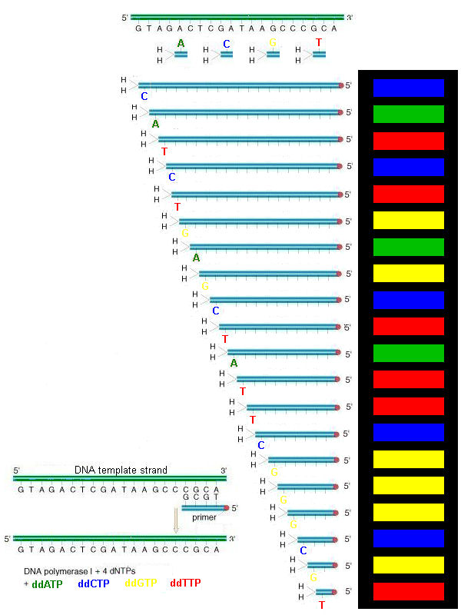
Whole-genome sequencing (WGS)
The DNA sequence is inferred from the sequence of fluorescence images

Slide 25
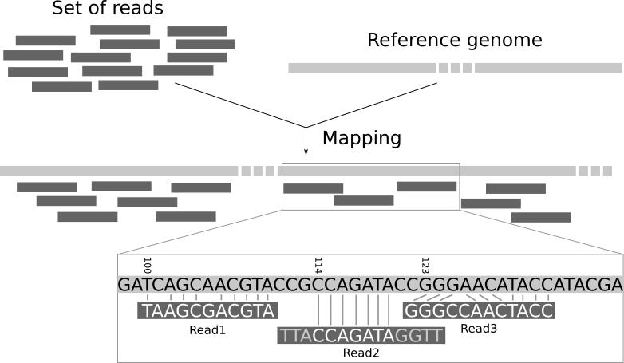
Mapping to the reference genome
Locate where in the genome the reads came from, and detect single-nucleotide differences from the reference sequence

Slide 26
Data-processing pipeline
Generate raw reads
Align to a reference genome
Detect variant sites

Slide 27
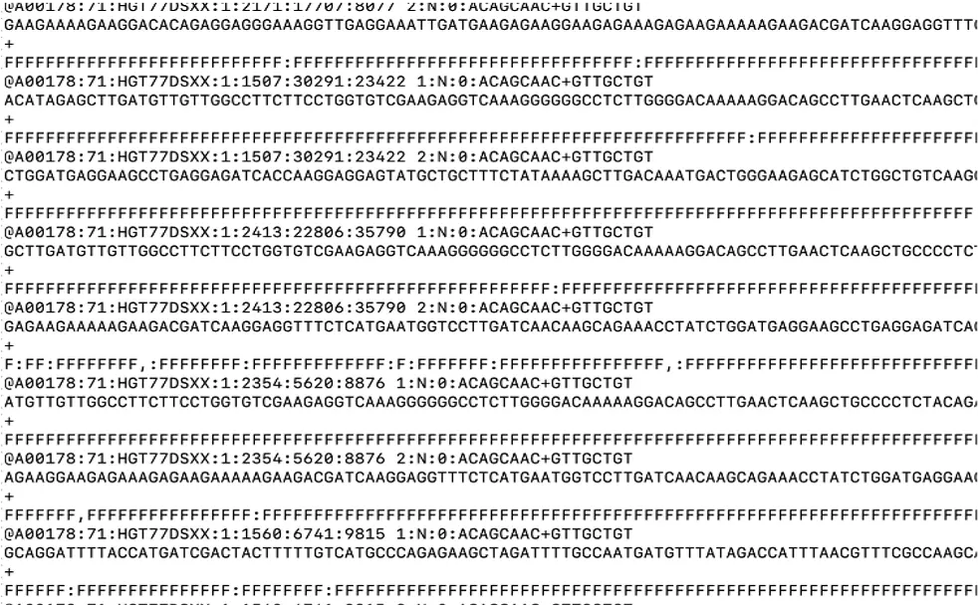
FASTQ
Contains raw sequence reads and their quality scores to be aligned to a reference genome (FASTA)

Slide 28
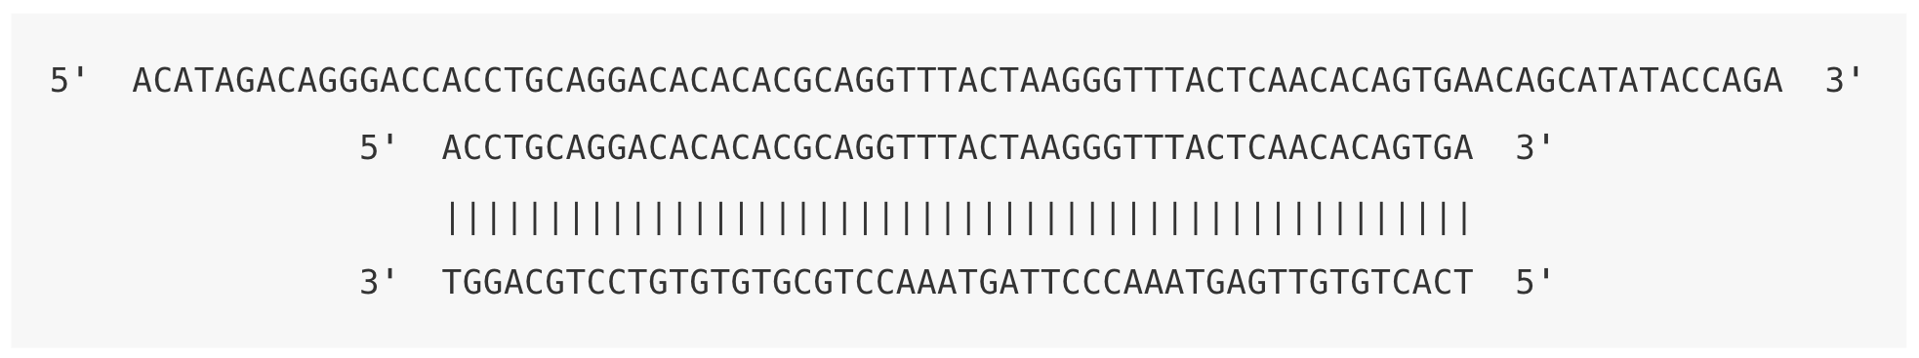
SAM (BAM)
Paired-end reads are aligned to either the forward or reverse strand of the reference genome
https://eriqande.github.io/eca-bioinf-handbook/bioinformatic-file-formats.html#sambamfiles

Slide 29
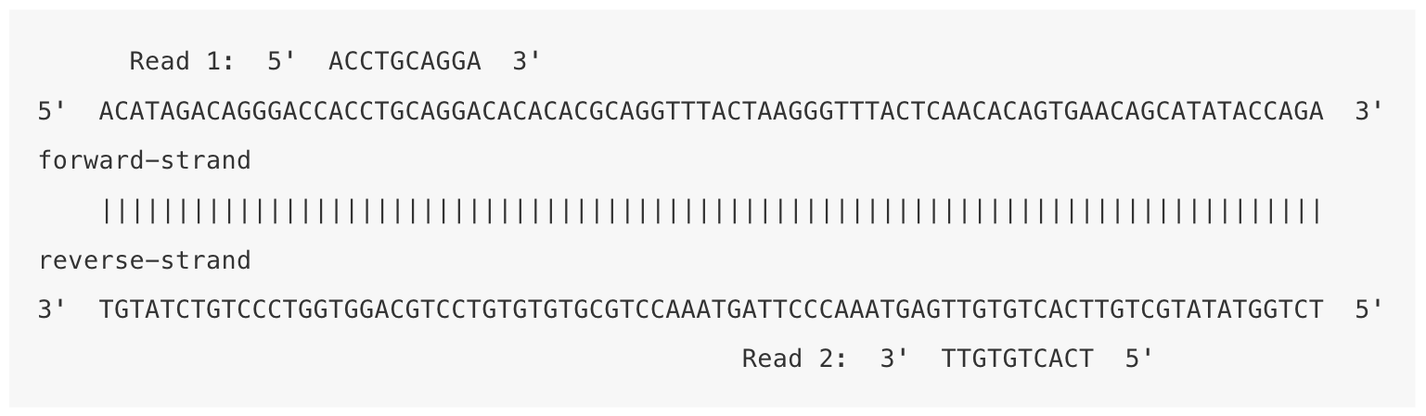
SAM (BAM)
Paired-end reads are aligned to either the forward or reverse strand of the reference genome
https://eriqande.github.io/eca-bioinf-handbook/bioinformatic-file-formats.html#sambamfiles

Slide 30
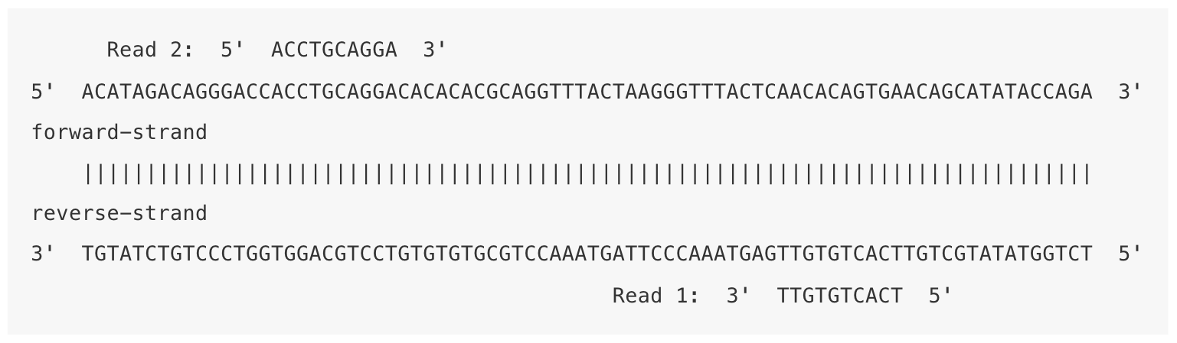
SAM (BAM)
Paired-end reads are aligned to either the forward or reverse strand of the reference genome
https://eriqande.github.io/eca-bioinf-handbook/bioinformatic-file-formats.html#sambamfiles

Slide 31
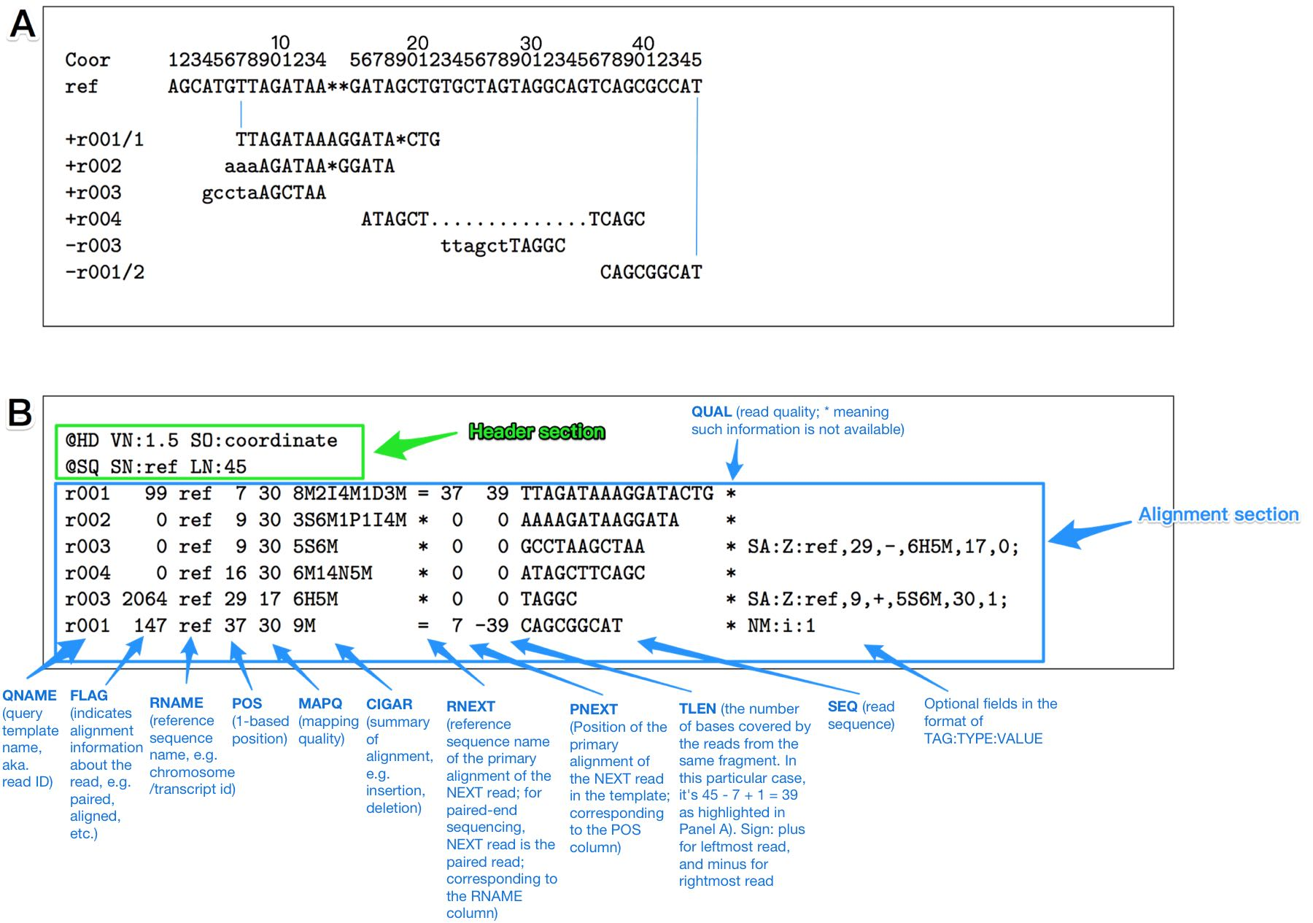
SAM (BAM)
A Sequence alignment map (SAM) or binary alignment map (BAM) file contains the alignments to the reference genome

Slide 32
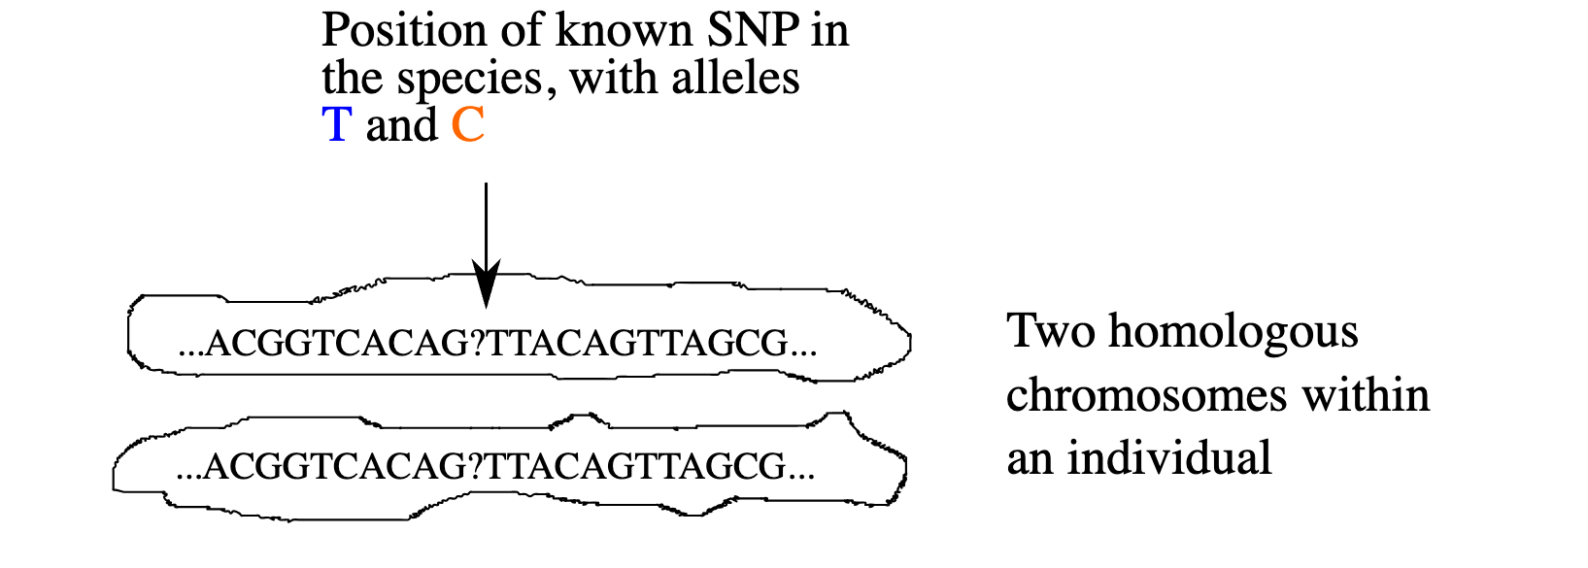
Variant calling (mpileup)
How certain can we be of an individual’s genotype?
https://eriqande.github.io/eca-bioinf-handbook/bioinformatic-file-formats.html#sambamfiles

Slide 33
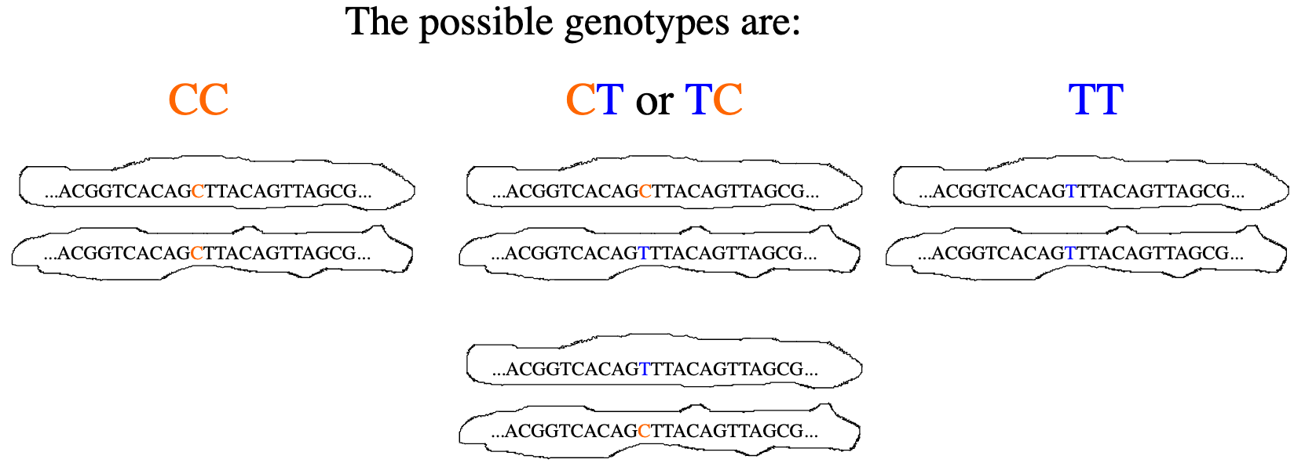
Variant calling (mpileup)
How certain can we be of an individual’s genotype?
https://eriqande.github.io/eca-bioinf-handbook/bioinformatic-file-formats.html#sambamfiles

Slide 34
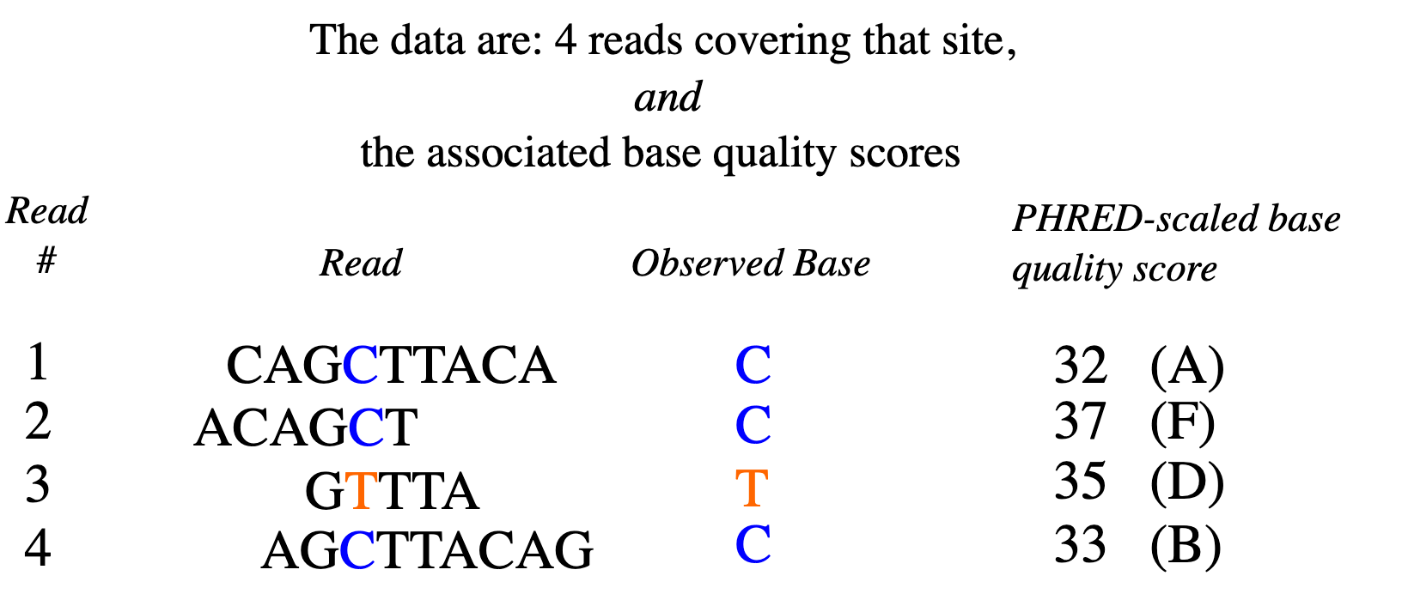
Variant calling (mpileup)
How certain can we be of an individual’s genotype?
https://eriqande.github.io/eca-bioinf-handbook/bioinformatic-file-formats.html#sambamfiles

Slide 35
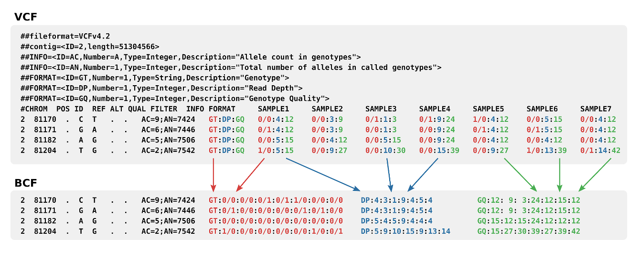
VCF
The results of genotype-calling are stored in a variant call format (VCF) file

Slide 36
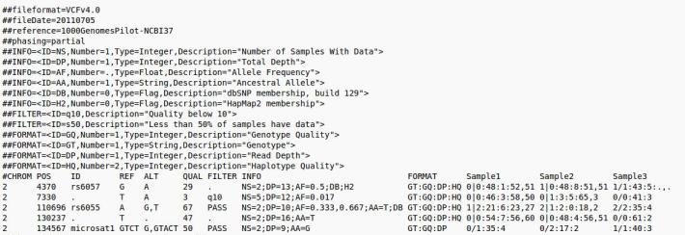
VCF
The VCF file has one row for each variant, and one column for each sequenced individual

Slide 37
VCF
Codes such as GT, DP, GP give the genotype, read depth, and genotype probabilities for each individual

Slide 38
Principal components analysis
The concept of genetic ancestry

Slide 39
The HapMap Project
International genotyping consortium launched in 2002 to find common polymorphisms linked to rare disease loci
https://pubmed.ncbi.nlm.nih.gov/16255080/

Slide 40
The HapMap Project
Variants occur together on a small number of haplotypes
https://pubmed.ncbi.nlm.nih.gov/16255080/

Slide 41
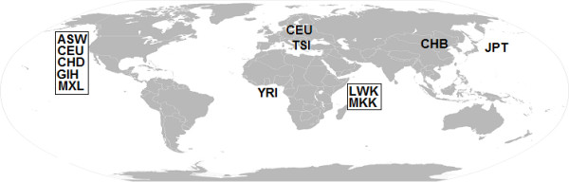
The HapMap Project
Phase 3 (2010): genotyping and PCR resequencing of 1.6 million SNPs from 1,184 human samples from different parts of the world

Slide 42
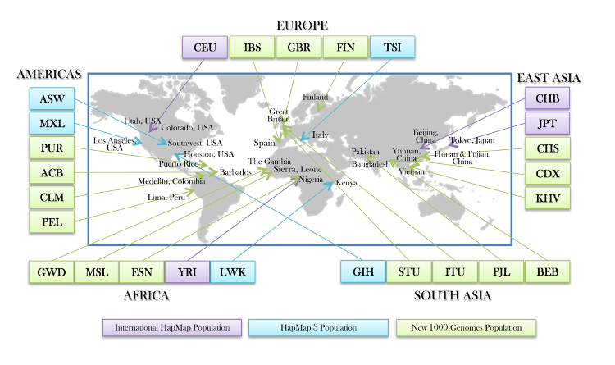
The 1000 Genomes Project
An international consortium launched in 2008 to catalog rare variants (frequency < 1%) taking advantage of new sequencing technologies

Slide 43
The 1000 Genomes Project
Phase 3 release (2015) contained data from 2,504 individuals representing 26 populations across the globe, and identified 85 million new SNPs

Slide 44
Global genetic variation
Most SNPs are shared across continents, and the majority of variation (~85%) is within rather than between populations

Slide 45

The same yet different?
Most variation is within-populations rather than between-populations
Yet regional differences in allele frequencies lead to noticeable differences in phenotypes

Slide 46
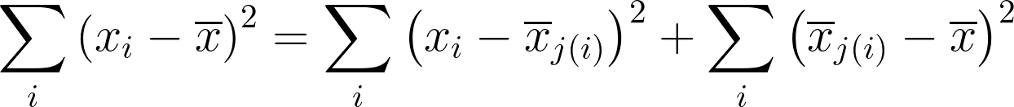
Statistical variation of an allele
Variation of the counts x_{i} of an allele about the group mean x̅_{j} and the population mean x̅
Total variation
Within-population variation
Between-population variation
Most SNPs are shared across continents, and the majority of variation (~85%) is within rather than between populations

Slide 47
Example: lactase nonpersistence (lactose intolerance)
The T allele of rs182549 is completely associated with the ability to digest lactose in Europeans
 | CC | CT | TT
Non-persistence | 59 | 0 | 0
Persistence | 0 | 63 | 74
https://pubmed.ncbi.nlm.nih.gov/11788828/

Slide 48
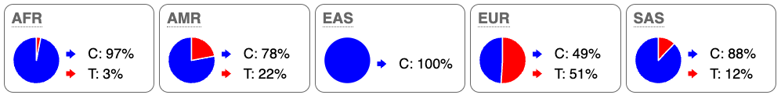
Example: lactase nonpersistence (lactose intolerance)
Yet the polymorphism is almost absent in the African population, despite the presence of lactase persistence https://pubmed.ncbi.nlm.nih.gov/15106124/

Slide 49
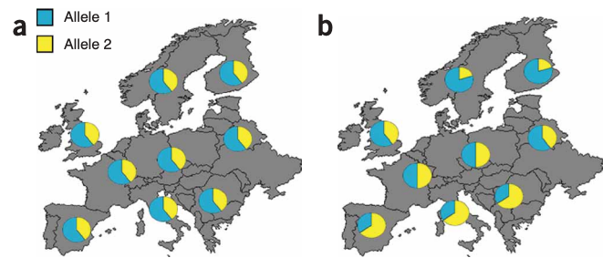
Population stratification
An allele may appear associated with a phenotype when in fact it is associated with geographic origin (genetic ancestry)

Slide 50
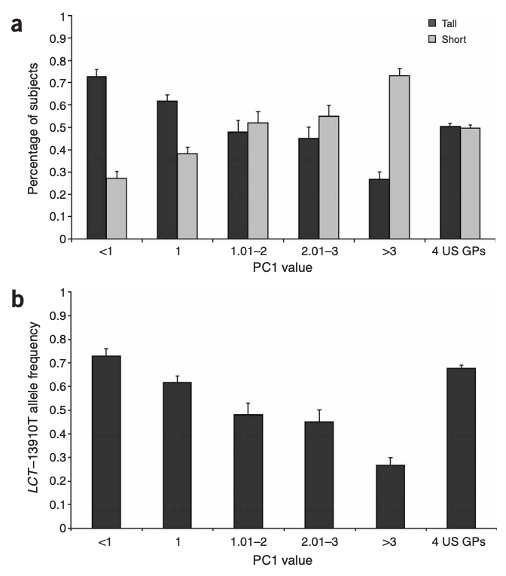
Spurious association
An allele of the lactase-persistence SNP is spuriously associated with height, as its frequency is higher in individuals with Northern European ancestry vs. Southern
Northwest
Southeast
https://pubmed.ncbi.nlm.nih.gov/16041375/

Slide 51
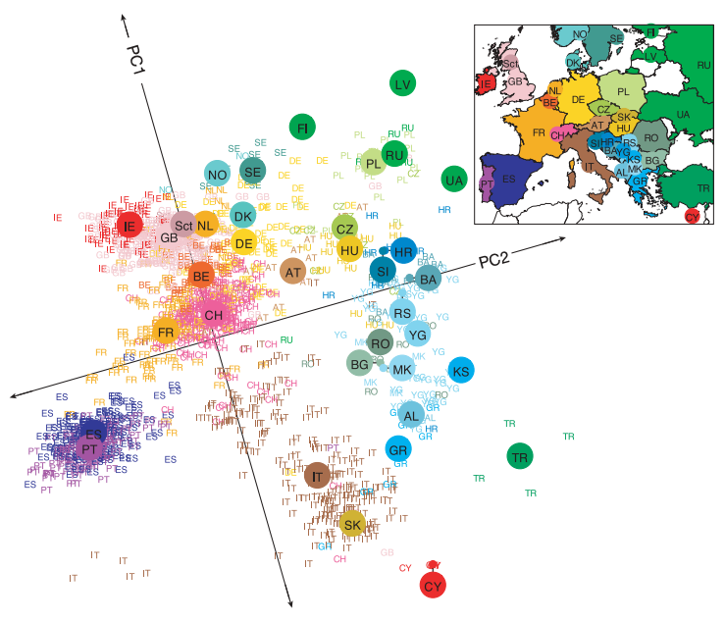
Principal components analysis
Genotypes can distinguish population groups
https://pubmed.ncbi.nlm.nih.gov/18758442/

Slide 52
Principal components analysis
Looking at which variants segregate together can tell us about an individual’s likely genetic ancestry
https://pubmed.ncbi.nlm.nih.gov/18758442/

Slide 53
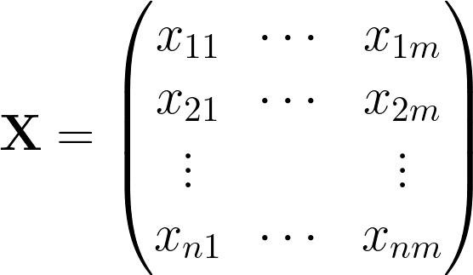
Genotype matrix
m SNPs
n individuals are genotyped at m SNPs
n subjects

Slide 54
Genotype matrix
The number of alternate alleles is 0, 1, or 2

Slide 55
Genotype matrix
“Standardize” each genotype by subtracting the mean allele (column) frequency and dividing by its standard error

Slide 56
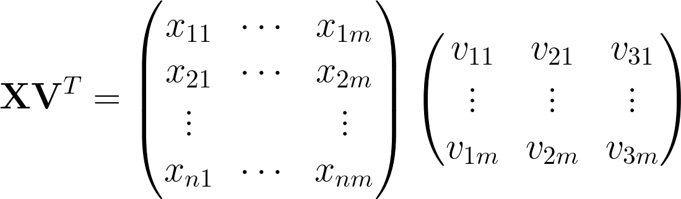
“Idealized” individuals
An “idealized” subject of a particular genetic ancestry has genotypes v at m SNPs

Slide 57
“Idealized” individuals
The position of individual 1 on PC1 is the “amount” of idealized person 1 in individual 1

Slide 58
“Idealized” individuals
The idea of PCA is to find the amount of each idealized individual in each actual individual

Slide 59
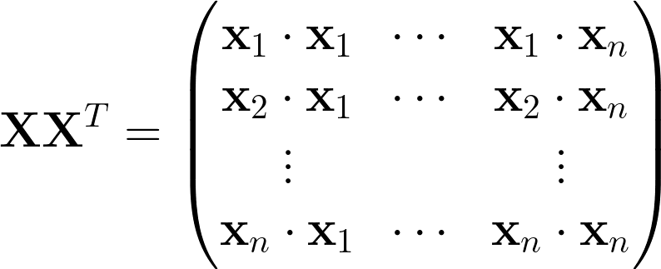
Genomic relationship matrix (GRM)
The GRM is computed by comparing how similar any subject is to any other

Slide 60
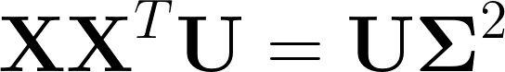
Genomic relationship matrix (GRM)
The eigenvectors (columns of U) of the GRM contain the ancestry components

Slide 61
Linkage disequilibrium
Determining a set of independent SNPs

Slide 62
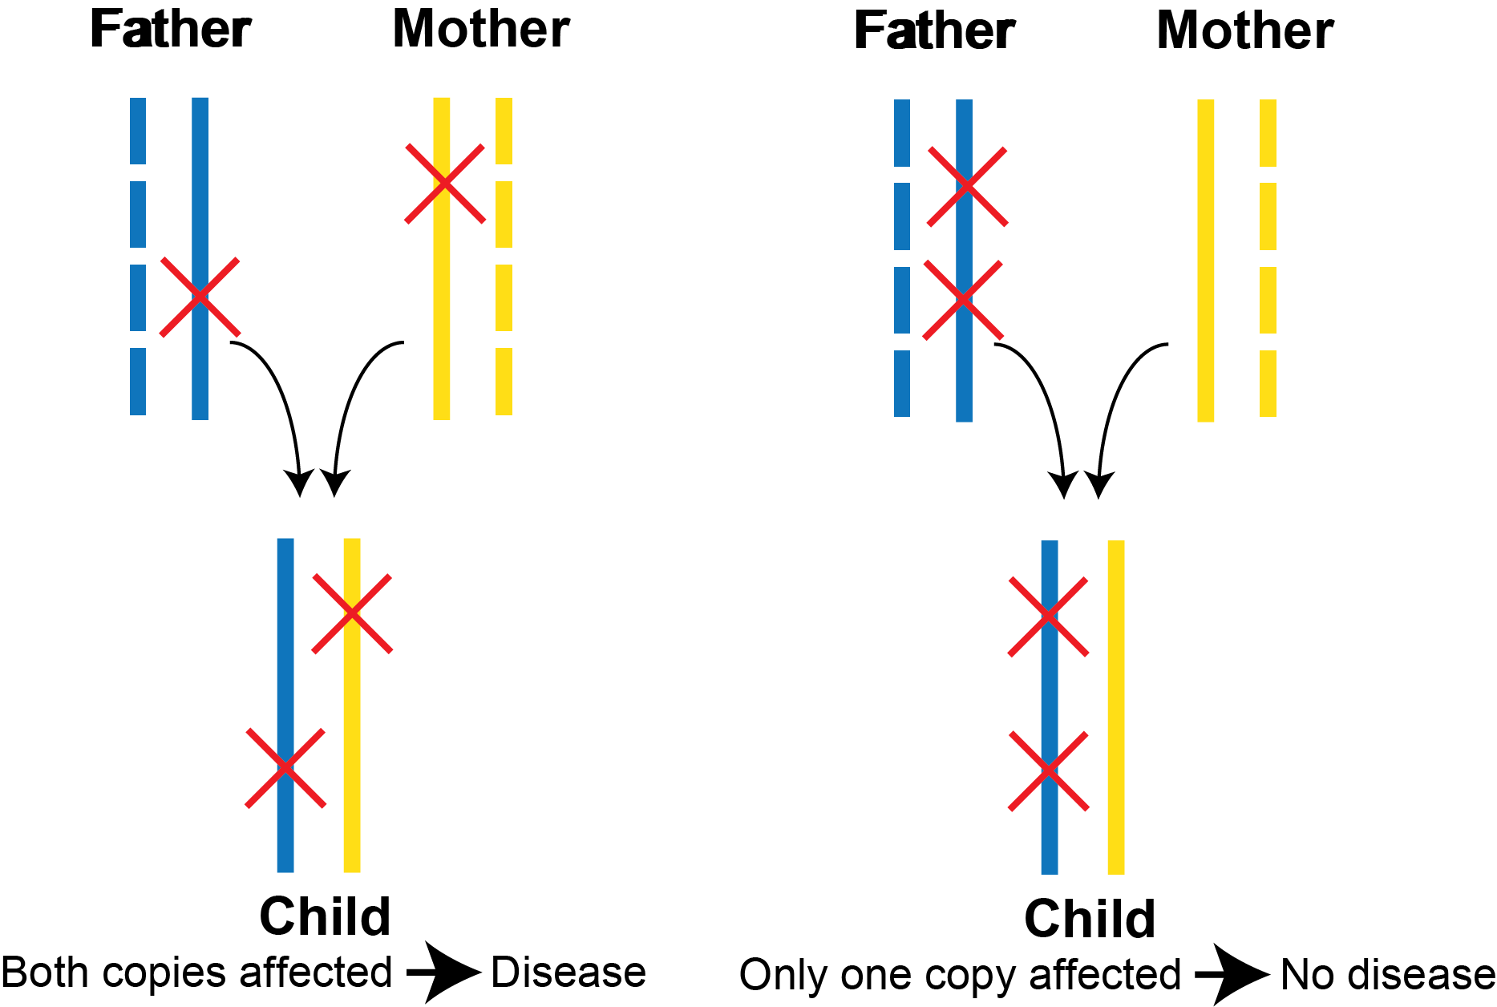
SNPs can occur on either of two chromosomes
Genotype data do not tell us which chromosomes carry the polymorphism
When at least one parent is homozygous at each SNP, haplotype phase can be unambiguously assigned

Slide 63
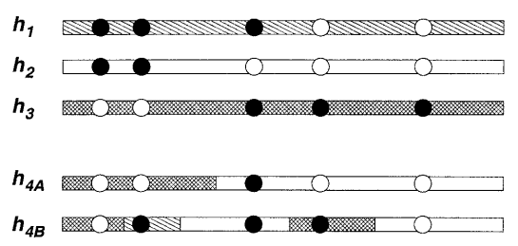
Statistical phasing and imputation
Genotyped individuals can be computationally phased by modelling each chromosome as an imperfect mosaic of chromosomes from a reference panel
https://pubmed.ncbi.nlm.nih.gov/14704198/

Slide 64
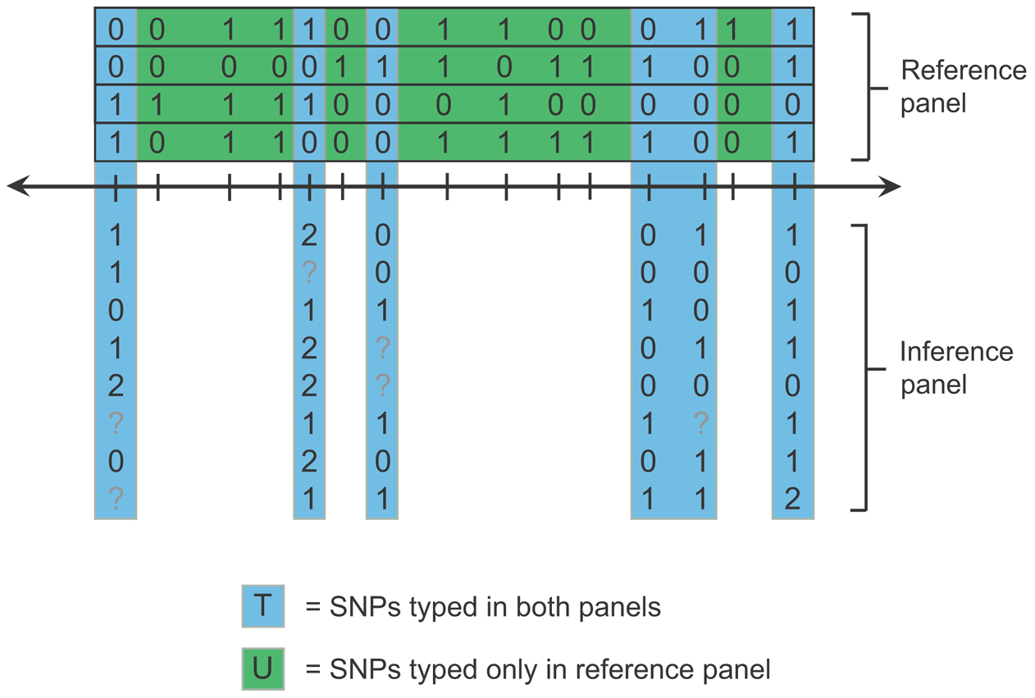
Statistical phasing and imputation
Variants that have not been typed can be imputed into the inference sample
Imputation accuracy depends on the inference and reference samples being of similar genetic ancestry
https://pubmed.ncbi.nlm.nih.gov/19543373/

Slide 65
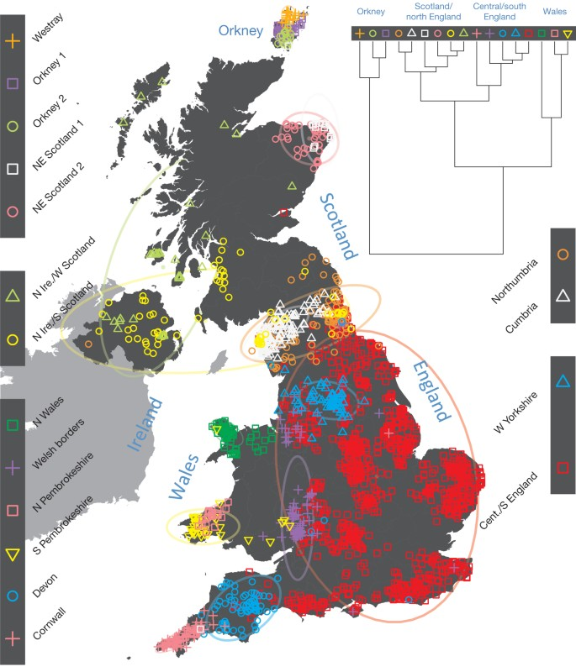
Different haplotypes distinguish different populations
Individuals can be grouped into populations with which they have the most haplotype-sharing
https://pubmed.ncbi.nlm.nih.gov/25788095/

Slide 66
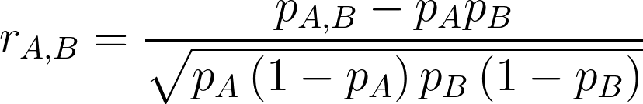
Linkage disequilibrium
Linkage disequilibrium is the population tendency of alleles to be inherited on a single chromosome and is measure using a correlation coefficient between the alleles of different SNPs

Slide 67
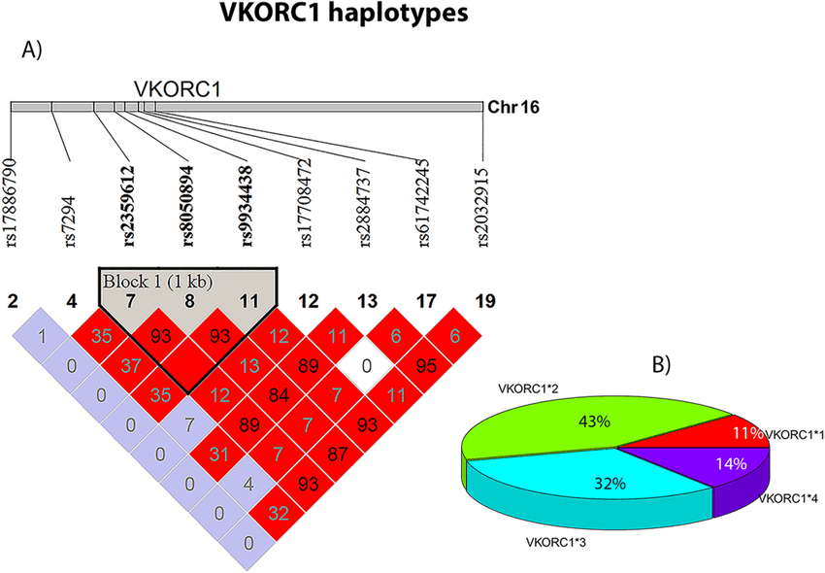
LD blocks and haplotype structure
Plots of pairwise r² values show which SNPs are inherited together in the population as common haplotypes
https://pubmed.ncbi.nlm.nih.gov/32221414/

Slide 68
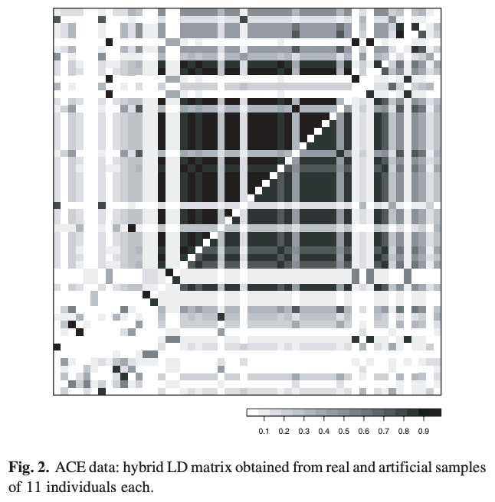
Haplotype simulation using LD
Simulate a haplotype by ensuring that the frequencies and LD between any two alleles match the reference data
No assumptions about phylogenies or knowledge of evolutionary theory is required
Real LD matrix
Simulated LD matrix
https://pubmed.ncbi.nlm.nih.gov/16188927/

Slide 69
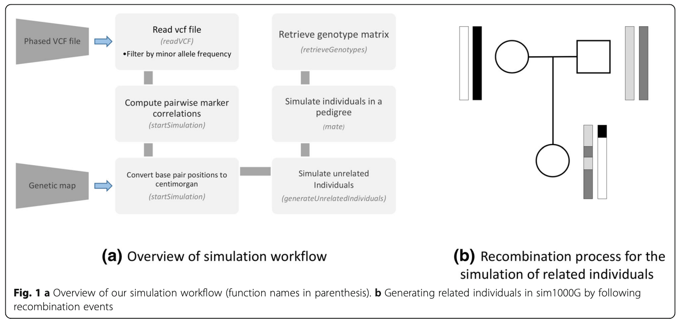
sim1000G: simulate haplotypes from an input vcf
https://pubmed.ncbi.nlm.nih.gov/30646839/

Slide 70
Kinship analysis
The concept of genetic relatedness

Slide 71
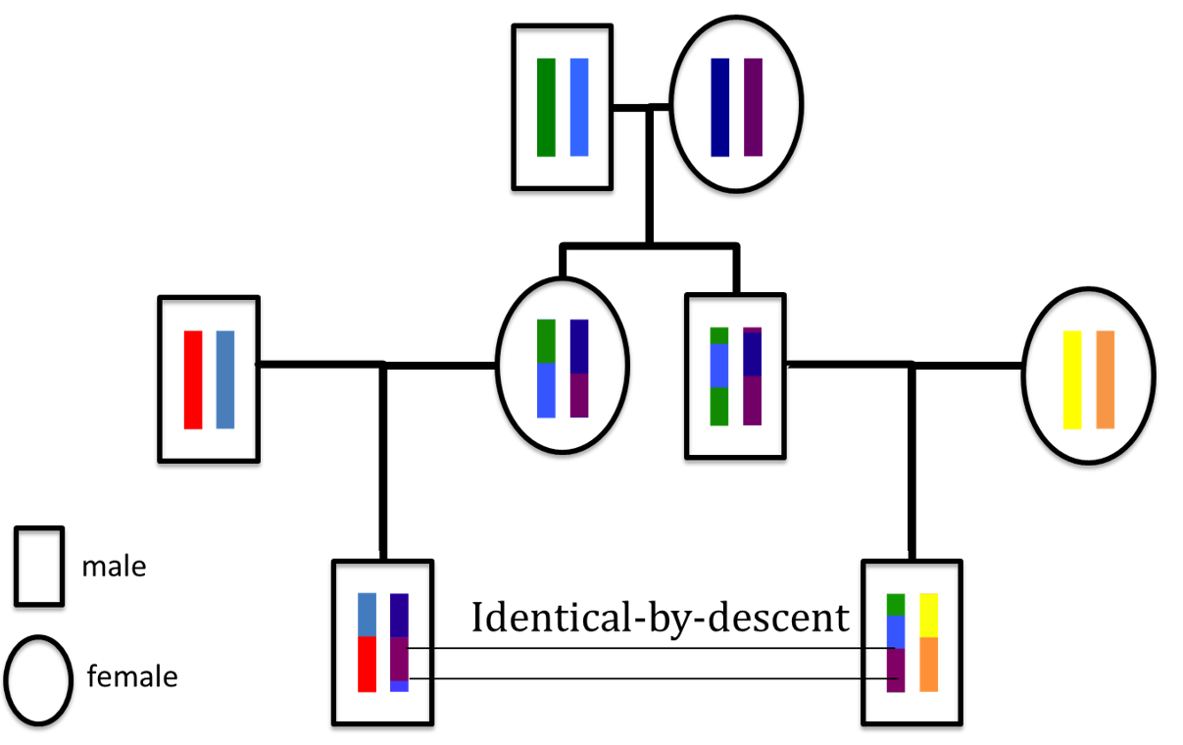
Relatives share haplotypes IBD
Segments of DNA inherited from a common ancestor are said to be identical by descent
DNA that just happens to be the same is identical by state

Slide 72
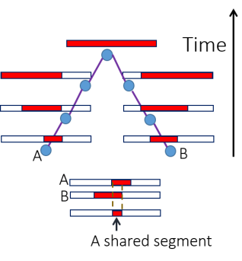
Haplotype sharing decays over time
The longer the IBD segment, the more closely related are the two individuals

Slide 73
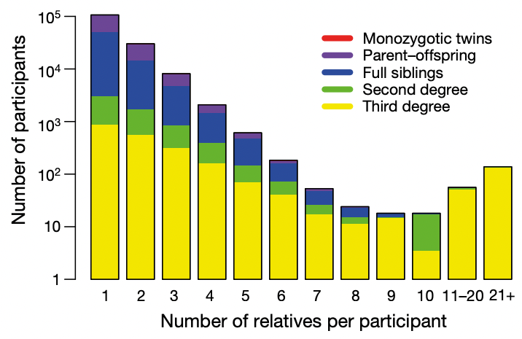
Kinship in genetic association studies
Genomic datasets, such as the UK Biobank, contain related individuals
Sometimes there is even “cryptic” relatedness
Because of IBD sharing, not all the observations are independent, and genotype-phenotype associations may be confounded
https://pubmed.ncbi.nlm.nih.gov/30305743/

Slide 74
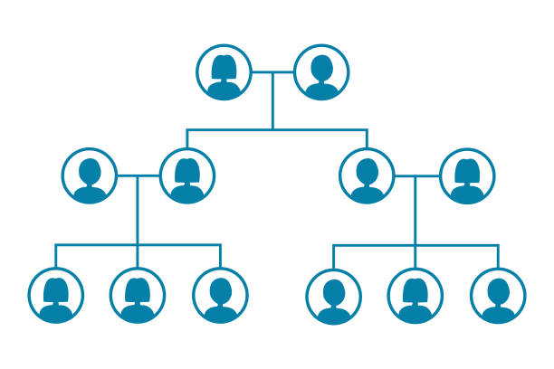
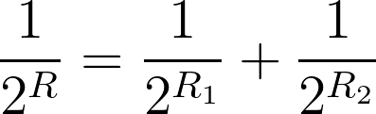
Degree of relatedness
R is the effective number of meioses separating two individuals through their two parents 1 and 2
R → ∞ for unrelated individuals

Slide 75
Degree of relatedness
Parent-child: R = 1 meiosis

Slide 76
Degree of relatedness
Siblings: R = 1 “effective” meiosis:
1 / 2¹ = 1 / 2² + 1 / 2²

Slide 77
Degree of relatedness
Grandparent-grandchild: R = 2 meioses

Slide 78
Degree of relatedness
Avuncular: R = 2 meioses

Slide 79
Degree of relatedness
Cousins: R = 3 meioses

Slide 80
Degree of relatedness and the fraction of the genome shared IBD
r = 1 / 2^{R} is the fraction of the genome shared IBD, because there is a ½ probability that the gene is passed on in each of R meioses

Slide 81
Degree of relatedness and the fraction of the genome shared IBD
A child shares half of its DNA with its parent
A child shares (a different) half its DNA with its full sib
Paternal chr.
Paternal chr.
IBD
IBD
Maternal chr.
IBD
IBD
IBD
IBD
Maternal chr.
IBD
IBD

Slide 82
Degree of relatedness and the fraction of the genome shared IBD
A child has 0 probability of IBD = 0 with its parent
A child has 0.25 probability of IBD = 0 with its sib
Paternal chr.
Paternal chr.
IBD
IBD
Maternal chr.
IBD
IBD
IBD
IBD
Maternal chr.
IBD
IBD

Slide 83
The coefficient of relatedness φ
φ is the probability that any two alleles at a single locus chosen from two individuals are shared IBD
φ is equal to half of r = 1 / 2^{R}
IBD
✕
✕
IBD
✓
✕
R = 1, r = ½, φ = ¼

Slide 84
Coefficient of relatedness and IBD = 0
φ decreases as the probability that a pair of individuals should be IBD = 0 increases
Relationship | R | φ | IBD = 0
Monozygotic twins | 0 | 0.5 | 0
Parent-child | 1 | 0.25 | 0
Full sibs | 1 | 0.25 | 0.25
2nd degree | 2 | 0.125 | 0.5
3rd degree | 3 | 0.0625 | 0.75
Unrelated | ∞ | 0 | 1

Slide 85
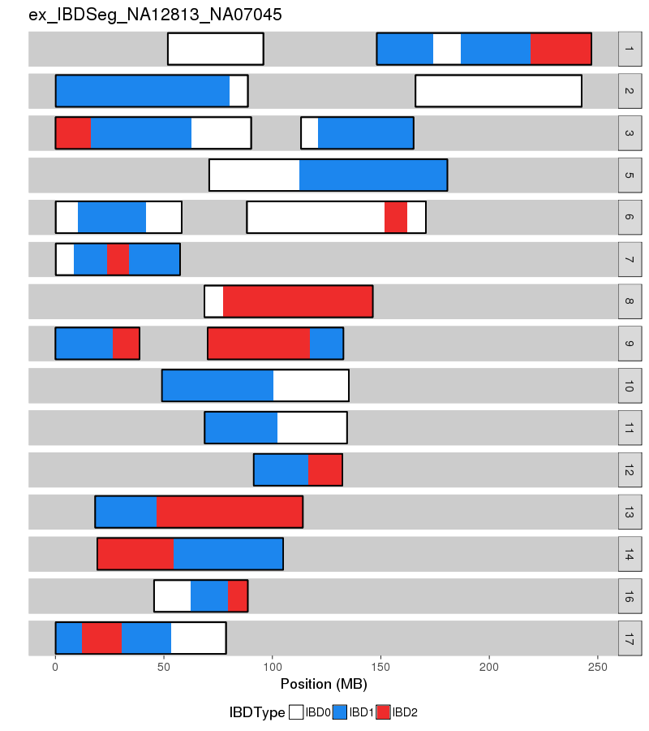
Kinship-based Inference for GWAS (KING)
Estimate φ and IBD sharing from the number of sites at which two individuals are both heterozygotes (Aa,Aa) or opposite homozygotes (AA,aa)
Avoids estimating population allele fractions, just focuses on pairs
https://www.kingrelatedness.com/manual.shtml

Slide 86
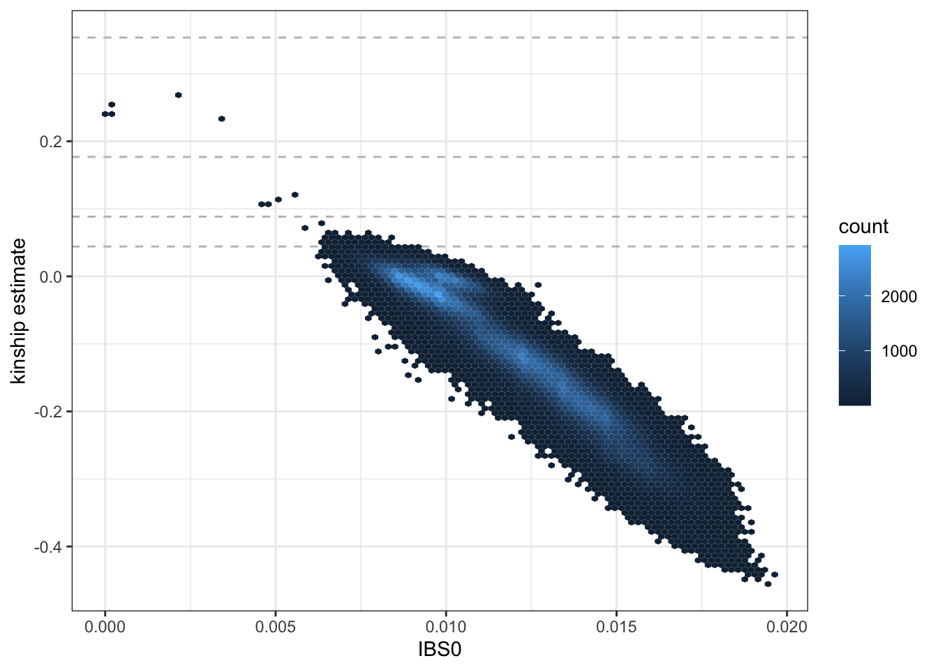
Kinship-based Inference for GWAS (KING)
φ is plotted vs. the fraction of IBS = 0 sites (AA,aa)
Negative estimates indicate unrelated individuals from different populations
https://uw-gac.github.io/SISG_2021/ancestry-and-relatedness-inference.html

Slide 87
Updating the GRM
The KING kinship coefficients 2φ are approximately equal to the GRM, but the estimate may be biased by population structure
i
j
i
2φ_{ij}
j
x_{j} · x_{i}

Slide 88
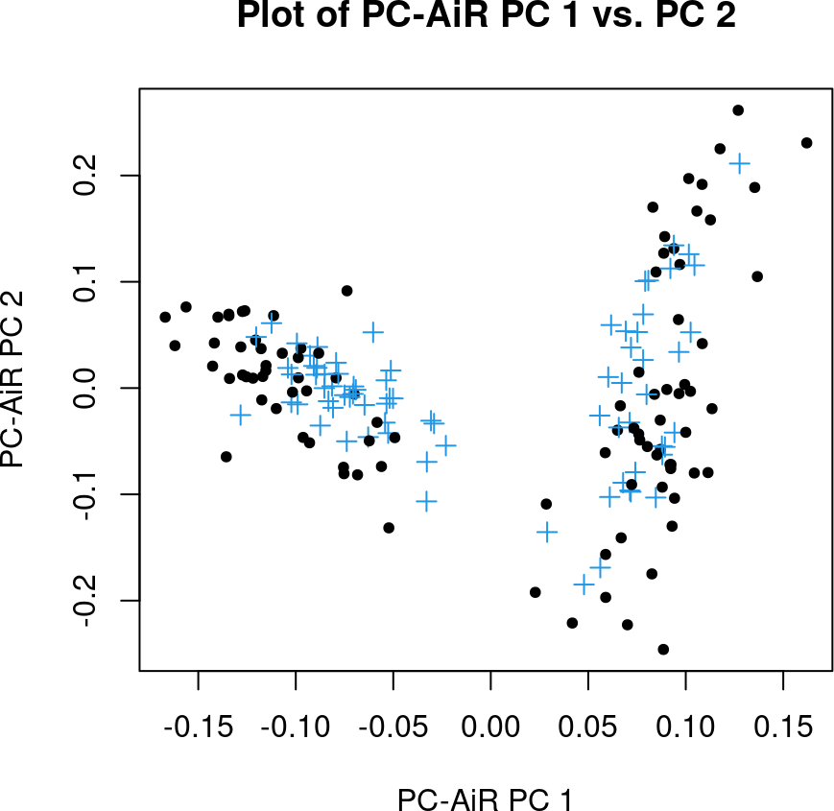
PC-AiR: PCA in Related Samples
Based on the KING estimates, PC-AiR computes PCs for a set of unrelated individuals (black)
PCs for the remaining samples (blue) are estimated from their similarity to the unrelated subset
https://bioconductor.org/packages/devel/bioc/vignettes/GENESIS/inst/doc/pcair.html

Slide 89

PC-Relate
PC-Relate uses the updated PCs to correct the GRM for population structure
The updated GRM reflects recent kinship only
https://pubmed.ncbi.nlm.nih.gov/26748516/

Slide 90
Association testing
Logistic regression and linear mixed models

Slide 91

Case-control studies
Is a genetic variant associated with disease?
Is a genetic variant enriched in people with disease compared to people without?
To find out, collect many people with disease (Cases) and many healthy individuals (Controls) from the same population

Slide 92
The odds ratio
The OR is the ratio of the odds that Cases have the risk allele (620 / 380) to the odds that Controls have the risk allele (490 / 510)
The OR is a crude measure of association that is not adjusted for other covariates (age, sex, ethnicity, etc.) that may also be associated with disease
Cases
Controls
C
620
490
T
380
510
OR = (620 × 510) / (490 × 380) = 1.70

Slide 93

Linear vs. logistic regression
In linear regression, we can find the association of a continuous variate Y with a predictor X₁ and other covariates X₂, X₃, etc.

Slide 94
Linear vs. logistic regression
In logistic regression, we can find the association of a binary variate Y with a predictor X₁ and other covariates X₂, X₃, etc.
The sigmoid curve is an individual’s probability of developing disease

Slide 95

Linear vs. logistic regression
Logistic regression can be thought of like linear regression is we transform the OR into the log(OR) and regress vs. SNP genotype

Slide 96

Linear vs. logistic regression
Other covariates can be accounted for as additional independent variables
The model is actually fit using the principle of maximum-likelihood

Slide 97
Simulating a binary phenotype
a
b
If odds = a / b, then prob = a / (a + b) = odds / (1 + odds)

Slide 98

Simulating a binary phenotype
a
b
β₀ is the baseline odds
β₁ is the log-OR
X₁ is the SNP genotype
If odds = a / b, then prob = a / (a + b) = odds / (1 + odds)

Slide 99

Simulating a binary phenotype
a
b
prob is the probability of developing disease (being a Case in the study)
If odds = a / b, then prob = a / (a + b) = odds / (1 + odds)

Slide 100

Simulating a binary phenotype
a
b
β₀ becomes the mean log-odds so that the mean odds of disease is 1 (50% Cases, 50% Controls)
If odds = a / b, then prob = a / (a + b) = odds / (1 + odds)

Slide 101
Estimating the SNP effect
We want to be able to detect the association of one SNP with disease by fitting the model Y = β₀ + β₁X₁ + ··· and finding a slope β₁ significantly different from 0

Slide 102

Estimating the SNP effect
A Manhattan plot gives the p-value of the log-OR estimate for each SNP

Slide 103
Estimating the SNP effect
Because there are more SNPs than subjects, we cannot fit all SNPs at once

Slide 104
Estimating the SNP effect
But we can fit one SNP plus the “average” effect of all the remaining SNPs

Slide 105
Linear mixed models
i
j
The solution for the best estimate of the SNP effect β₁ in the presence of all the remaining SNPs involves the GRM ZZ^{T} (from PC-Relate)
i
2φ_{ij}
j
z_{j} · z_{i}

Slide 106
Linear mixed models
Other covariates commonly included in the model are age, sex, and the first few genotype principal components (from PC-AiR)

Slide 107
Linear mixed models
If the model including the SNP represents a significant improvement over the null model (the model without the SNP), we can reject the null hypothesis that the OR = 1

Slide 108
Linear mixed models
But because of multiple-testing, our p-value threshold is 0.05 / 10⁶ (i.e., you perform the same test 10⁶ times)
SNPs with p < 5.0 × 10⁻⁸ are said to achieve genome-wide significance
5.0 × 10⁻⁸

Slide 109

QQ plots
To assess if the distribution of SNP effects is significantly different from that expected by chance, we make a quantile or QQ plot

Slide 110
QQ plots
Put the observed p-value (negative log-10) in order from smallest to biggest

Slide 111
QQ plots
The expected p-values for the quantiles of m SNPs, are 1/m, 2/m,..., 1
Take the negative log-10 and put in order from smallest to biggest

Slide 112
QQ plots
SNPs falling above the line of identity indicate an excess of quantiles (β’s) with small p-values

Slide 113
Common data formats
How genotype data are stored

Slide 114

MAP
PLINK file containing the locations and names of SNPs

Slide 115

PED
PLINK file containing genotypes and phenotypes of individuals in different families

Slide 116

GDS
Genomic data structure used for conducting GWAS in R

